Slide 1
Proof Of Concept Project
HARPREET SINGH
Intern at Taken Mind Inc.

Slide 2
Problem Statement
The data is for company X which is trying to control attrition. There are two sets of data: "Existing employees" and "Employees who have left".
Following attributes are available for every employee.
Satisfaction Level
Last evaluation
Number of projects
Average monthly hours
Time spent at the company
work accident
promotion in the last 5 years
Departments (column sales)
Salary Whether the employee has left

Slide 3
Objective
What type of employees are leaving?
Determine which employees are prone to leave next.

Slide 4
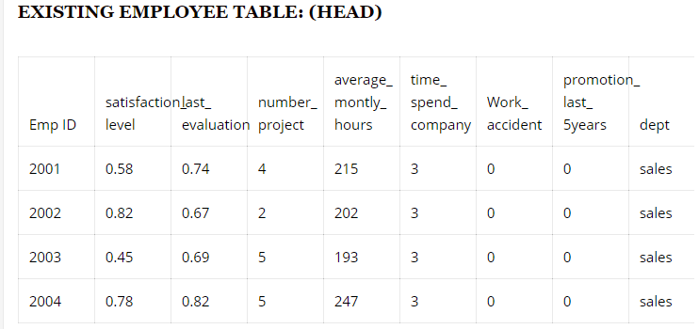
Existing Employee Table

Slide 5
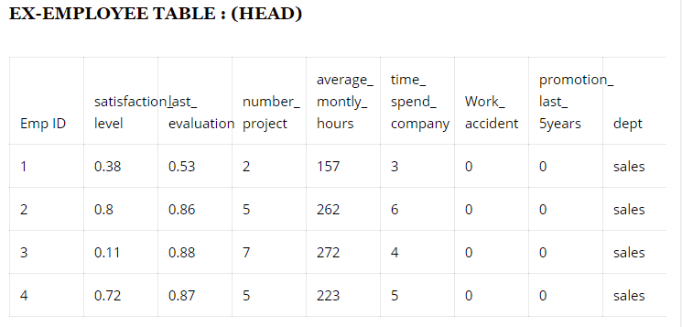
Ex- Employee Table

Slide 6
Data Analysis(Ex- Employee Table)
From the given data set, the following observations were noted:
Employees with low satisfaction level leave the company.
Employees with high average_working_hours will leave.
Employees with low salary will leave.
Satisfaction Level is inversely proportional to average_working_hours.

Slide 7
Data Analysis Results
Average-
Satisfaction level- 0.44
Number of projects – 3
Monthly Hours- 208
Time Spent In Company – 4 hrs

Slide 8
Predicting The Result
Algorithm-
If(satisfaction_level <0.4)
{ #employee leaves }
Else if(monthy_hours>210 && salary==low)
{#employee leaves}
Else if(no_of_projects<2)
{#employee leaves}
Else if(no_of_projects>3 && salary==low)
{#employee leaves}
Else if(monthly_hours>210 && time_spent_in company>4)
{#employee leaves}
Else
{#employee does not leave}

Slide 9
Conclusion
Employee attrition can be predicted by using the algorithm shown the above slides.
Steps to implement this algorithm:
Data Pre-processing
Data Analysis
Estimation based on analysis
Result

Slide 10
FROM HARPREET SINGH
THANK YOU!!!!

